Slide 1
Chapter 14: Surveys and Scale Development

Slide 2
Surveying the Landscape (1 of 6)
Survey: organized collection of questions.
Two ways of data collection:
  Using a set of unrelated questions.
  Measuring abstract concept or construct.
Notes:
Survey:
Questionnaires and surveys are organized collections of questions.
Researchers use them to get lots of answers and lots of data quickly and easily.
The word “survey” is used in different contexts like when observing someone carefully or when mapping something, etc.
Questionnaires also do the same things.
Two ways of data collection:
From a scientific standpoint, data can be collected in two ways by surveys and questionnaires.
First, one may use a set of unrelated questions to gather demographics and biographical information about people in order to describe them.
Second, one may be interested in measuring some abstract concept or construct such as feelings or personality traits.

Slide 3
Surveying the Landscape (2 of 6)
Scales: groups of questions tapping into the same thing.
When to use?
Notes:
Scales: groups of questions that all tap into the same thing.
Situation in which surveys use scales: When surveys measure abstract fuzzy concepts, they use scales.

Slide 4
Surveying the Landscape (3 of 6)
Functions of scales:
  Combine the responses to the many questions to create a single total score.
  Produce more valid scores.
  More reliable than asking a question.
Notes:
Functions of scales:
Scales combine the responses to the many questions to create a single total score that represents the concept.
Scales produce scores that tend to be more valid because they each measure different “slices” or aspects of the construct.
And they tend to be more reliable than asking a question because any randomness in responses tends to be minimized than asking a single question.

Slide 5
Surveying the Landscape (4 of 6)
Developing a scale is like developing different tests.
Steps in scale development.
  Define the construct to be measured.
  Generate an item pool.
Notes:
Developing a scale is like developing different tests: The steps to developing a valid and reliable scale is much like the steps involved in developing achievement tests and personality assessments.
Steps in Scale Development:
Define the construct to be measured:
Determine what is to be measured.
While defining the construct, someone who is high in this characteristic and someone who is low in this characteristic should be described.
To do this for research variables that are abstract constructs, use theory as an aid to clarity.
While measuring elusive phenomena that cannot be directly observed, if an existing conceptual framework that was developed by other researchers defines the construct, then it can be used.
To help in writing items, use specificity as an aid to clarity.
Generate an item pool:
It takes lots of questions to get to the construct.
The pool will be revised later and items that do not work well are removed.
There is no need to worry about whether a question belongs on the scale for sure or not.

Slide 6
Surveying the Landscape (5 of 6)
  Determine the format for measurement.
  Review the item pool.
  Consider including validation items.
Notes:
Determine the format:
The format for the measurement can be questions or statements that people either agree or disagree with.
They can also be tasks that a person forms.
This step involves determining the format of the measurement.
Review the item pool:
If there are experts who know a lot about what the research variable is and how it should be measured, then they can evaluate the questions.
For example: While measuring social anxiety, one can consider emailing a researcher in that area and asking if they will review your pool of potential items.
Alternatively, one can also take the help of a focus group too.
Consider including validation items:
Before trying out the scale, one can include an existing measure that assesses something similar to the measured construct.
Later, the scores from the scale can be correlated with that other measure.
If the correlations are high, that counts as validity evidence.
There are many other ways to validate scores from a measure but a correlation with a similar measure is persuasive and for many cases, it is the strongest evidence possible.

Slide 7
Surveying the Landscape (6 of 6)
  Administer items to pilot sample.
  Evaluate items.
  Produce the final scale.
Notes:
Administer items to pilot sample:
In this step, the survey is given to a sample of people similar to those that are being researched.
If the sample is big enough, then reliability analyses can be done and correlational “validity coefficients” can be produced to confirm what is being measured.
Evaluate items:
This step provides the chance to make changes to improve the scales and the entire survey instrument.
Things like removing one or more bad items, time taken for the survey, etc., are evaluated.
Produce the final scale:
After the data from the pilot administration is evaluated, then the scale can be refined.
This step can involve small tweaks or a complete overhaul.
Finally, the hand-made instrument is ready to be used for a study.

Slide 8
How Do I Ask It in the Form of a Question? (1 of 6)
Non-threatening questions.
  Make the topic salient.
  Provide reminders.
  Ask about recent behavior.
Notes:
Make the topic salient:
Questions can be threatening or non-threatening.
While collecting factual information, there is no need to feel threatened.
There are many ways that help to collect factual information and the first is to make the topic salient (memorable or outstanding).
For instance, the question “What were you doing during the morning of the day that your first child was born?” makes it easy for people retrieve information more vividly and give accurate answers.
Provide reminders:
Give reminders of the context of the question.
For example, “Tell me about the concert you went to last year? Remember it rained that morning and the opening act was Uncle Dirtytoes?” works better than “Tell me about the concert you went to last year? Remember it rained that morning and the opening act was Uncle Dirtytoes?”
Ask about recent behavior:
To know about typical behavior, one should ask about recent behavior.

Slide 9
How Do I Ask It in the Form of a Question ?(2 of 6)
Threatening questions.
  Respondents may be paranoid when asking questions about behavior.
Notes:
Threatening questions:
People responding to survey questions, especially about behavior, may be paranoid that their answer is not in adherence to a socially desirable response.
A socially desirable response is the answer that other people think is morally correct or normal.
So, when people are paranoid, they tend to fib about their behaviors and judge that they might be viewed negatively.

Slide 10
How Do I Ask It in the Form of a Question? (3 of 6)
Strategies to question behavior.
  Use of long questions.
  Use of loaded questions.
Safely telling the truth: random sampling.
Notes:
Use of long questions:
When respondents read through some detailed preliminary text describing the behavior in question, they can come to feel that their own behavior is acceptable.
A long question appears like the researcher is treating the question like there might be a variety of ok responses.
Use of loaded questions:
Questions worded in a way to influence a certain response are called loaded questions.
Such questions give the encouragement to “admit” that one can engage in the behavior.
It is unlikely that someone who has never engaged in the behavior of interest will lie and say they have; whereas it is possible that, without encouragement, those who have done something that they fear is wrong will lie.
Some strategies to write leading questions are:
Claim that everybody does it.
Use non-specific authorities to justify the behavior.
Provide good reasons for the behavior.
Safely telling the truth: random sampling:
There is a very clever technique that allows people to be honest in answering threatening question.
The technique is called random responding and no one will even know what question is answered.

Slide 11
How Do I Ask It in the Form of a Question? (4 of 6)
An example of random responding.
  The two questions to consider.
  Instructions to be given.
  Working out the math.
Notes:
An example of random responding:
The two questions to consider:
Were you born in January?
Have you ever shoplifted from a store?
The first question is non-threatening.
But the second one is threatening and has a clearly socially desirable answer which is no.
Instructions to be given:
In this case, to use random responding, the following instructions are given.
Flip a coin. If it comes up heads, answer question number 1. If it comes up tails, answer question number 2.
In a room full of strangers, everyone’s answer can be read out loudly and one would feel safe giving the answer on an anonymous survey.
Working out the math:
For the researcher to know which “Yes” applies to which question, the math must be worked out as below.
Assume 100 people take the survey and there are 34 “yes” in the responses.
It is known that about half of the respondents (50 people) answered Question 1 about the month in which they were born.
By chance, the researcher can expect 1 out of 12 people to be born in any given month.
1 out of 12 is about 8% and so out of 50 people, there should be 50 X .08 = 4 yes responses.
So, that means that of the 34 yes responses, about 4 of them were answering the first question.
Consequently, 30 of them would have answered the second question but we already have 50 people answering this question.
Therefore, it can be concluded that 30 out of 50 people said they have shoplifted (60%).
This is a fairly accurate estimate of shoplifting rates without anyone ever feeling at risk for being found out.

Slide 12
How Do I Ask It in the Form of a Question (5 of 6)
Questions about Attitudes: Handling more abstract things.
Guidelines for writing valid attitude questions.
  Keep it simple.
  Keep it balanced.
Notes:
Handling more abstract things:
Sometimes one may have to measure more abstract things like opinion (and not the truth) or feelings (not behavior).
Such fuzzy questions appear on attitude surveys.
For such cases, there are some good rules for writing valid attitude questions (questions which are often written as statements).
This advice assumes that questions are non-threatening.
Guidelines for writing valid attitude questions:
Keep it simple:
Get to the point quickly and precisely with attitude items.
Try a simple form like “The Socrates Project provides a faculty mentor for at-risk students. I support the project” rather than opting for something bigger and more complicated.
Keep it balanced: Do not lead people one way or another.

Slide 13
How Do I Ask It in the Form of a Question?(6 of 6)
Avoid double-barrelled questions.
Avoid negatives in questions when possible*
Notes:
Guidelines for writing valid attitude questions:
Avoid double-barrelled questions:
Poorly written questions sometimes ask about two different things at once.
For example: Instead of The training was informative and interesting, try, The training was informative. The training was interesting.
Avoid negatives in questions:
A little extra “not” in a statement is easily missed and could lead to invalid responses.
Instead of “Convicted felons should not be allowed to vote” , one can try “Convicted felons should be allowed to vote.”
*Negatives can be used as a reliability check when done correctly

Slide 14
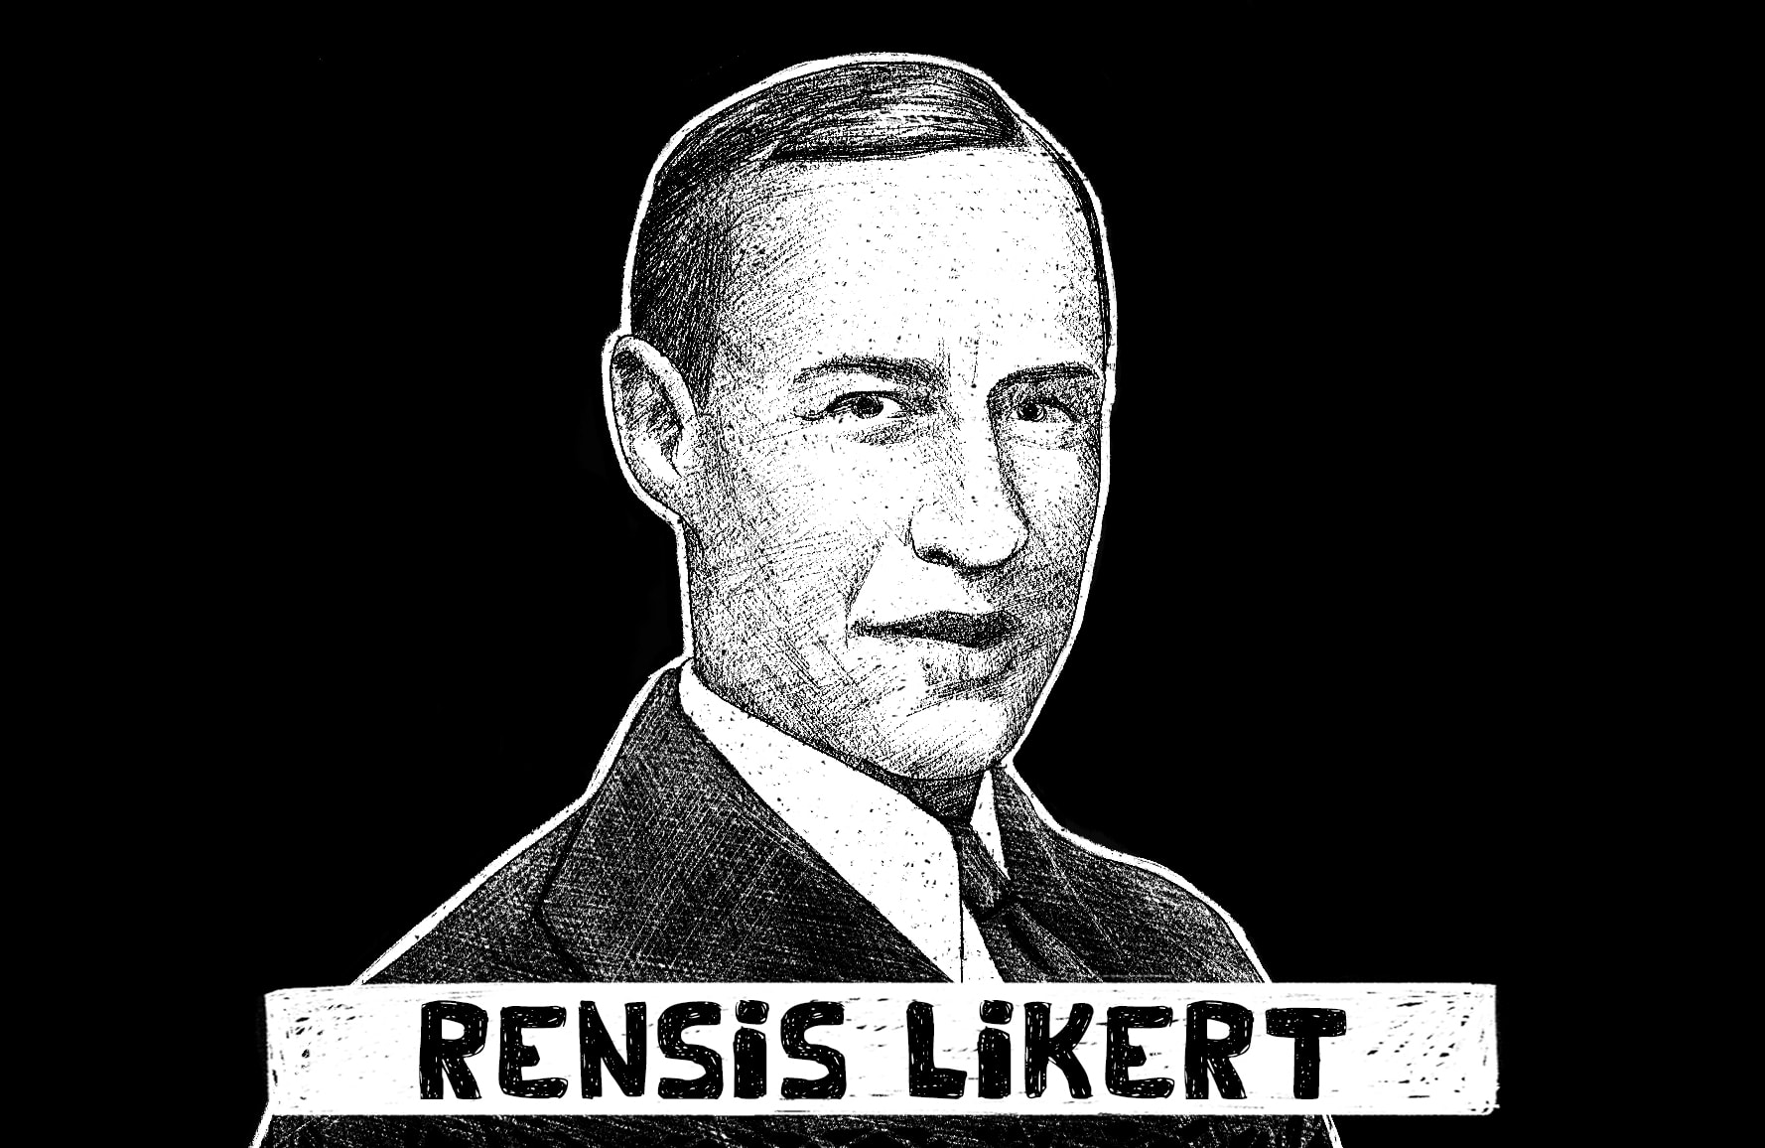
Likert Scales (1 of 2)
The most common format for attitude items.
Origin of the Likert format.
A Likert-type of item.
Debate over proper use of Likert items.
Notes:
14.3. Compare and contrast different attitude measurement strategies.
Our Feelings about Attitude: Most Like Likert (but Some Like Thurstone More)
The most common format for attitude items:
I like peanut butter:
Strongly disagree: 1.
Disagree: 2.
Neither agree nor disagree: 3.
Agree: 4.
Strongly agree: 5.
Sometimes the words or the answer options are different.
The general strategy of giving a statement and asking people whether they agree or disagree on some continuum is called a Likert format.
Origin of the Likert format:
The approach is named after Rensis Likert who is psychologist from the 1930s.
He suggested that both this format and that one could create a group of such items (the idea of a scale) and combine responses to get a valid and psychometrically sound measure of feelings and attitudes
A Likert-type of item:
An item is identified as a Likert item when the answer options are symmetrical and balanced.
Symmetrical refers to an equal number of positively and negatively perceived answer options.
Balanced implies that an effort is made to make the “distance” between each answer option about equal.
Debate over proper use of Likert items:
Researchers use scores from the measures to conduct statistical analyses and answer research questions.
There is some debate among statisticians about the proper way for researchers to use scores from Likert items.
The debate is around the about the level of measurement.
A higher level of measurement gives more information and one of the highest levels of measurement is interval level.
Interval level measurement means that the scores from some measure are such that the intervals or distances between any two adjacent scores is equal.
This quality is true everywhere along the scores and this is important because if scores are at the interval level, then it makes sense to summarize them with means and standard deviations.
Means and standard deviations can then be compared with t tests and analyses of variance and can be correlated with each other and all sorts of fancy statistics can be used on them.

Slide 15
Likert Scales (2 of 2)
The problem in analysis.
The use of scales is ideal.
Knowing the level of measurement.
Notes:
The problem in analysis:
Since Likert items are designed to be balanced in that equal interval way, they may appear to be perfect for statistical analyses like the one mentioned earlier.
But the problem is that a single Likert item probably is not equal interval.
For example, the distance between strongly disagreeing and just disagreeing may or may not be equal to the distance between strongly agreeing and just agreeing. Also, that distance may or may not be equal to the difference between agreeing and having a neutral attitude.
Therefore, when a single Likert item does not meet the definition of interval level measurement, powerful statistical methods that require that high level of measurement shouldn’t be used.
The use of scales is ideal:
Likert was all about combining a bunch of the items into a scale to create a total score that summarizes those item responses.
That total score is likely to be more valid and reliable than a single item’s score.
Also, it is a lot closer to meeting the needs of statisticians in terms of being at that elusive equal interval level.
Clearly, there are lots of good reasons to use scales to measure a contruct instead of a single item
Knowing the level of measurement:
To know the level of measurement at which the measurement should be done, the scores used for high level statistical analyses need to be normally distributed.
In other words, the scores need to be from a distribution of scores that are shaped like the well-known bell curve.
Conveniently, if scores are normally distributed, then we can assume they are at the interval level

Slide 16
Thurstone Scales (1 of 4)
The Thurstone Method
An alternative approach to attitude assessment.
Origin of the Thurstone way.
Likert vs. Thurstone
Notes:
An alternative approach to attitude assessment:
Another approach to attitude measurement is the Thurstone way.
Statisticians find this approach more satisfying than the Likert approach in terms of producing interval level scores.
Since the approach takes twice as much work and twice as much time to develop, it is not commonly used.
However, the approach is clever and the best practice thus far.
Origin of the Thurstone way:
The social psychologist Louis Thurstone was the first to develop whole theories about what an attitude is and how to measure it.
He suggested that one could create a bunch of attitude statements all referencing the same thing and ask people if they agree or disagree with the statements.
Comparison between Likert and Thurstone ways:
Thurstone’s suggestion is similar to what Likert suggested a few years later in terms of a scale of items that all sample the same construct.
The different between the two ways is that Thurstone items are all worth a different amount of points but with Likert, everything is the same.
For instance, if an individual agrees with just two statements that are only mildly strong, their score is the same as someone else who agreed with two different items that were strongly worded.
So, the two individuals have a different “amount” of the attitude, but are treated as if they have the same amount of the attitude.

Slide 17
Thurstone Scales (2 of 4)
The Thurstone Method
Steps to create a Thurstone scale:
  Choose the attitudinal object.
  Write multiple statements about the object.
  Create a panel of judges.
Notes:
Steps to create a Thurstone scale:
Choose the attitudinal object: Choose an attitudinal object that you can write opinion statements about. Example: Peanut butter.
Write multiple statements about the object:
\
Create a panel of judges.

Slide 18
Thurstone Scales (3 of 4)
The Thurstone Method
  Choose the attitudinal object.
  Write multiple statements about the object.
  Create a panel of judges.
Notes:
Choose the attitudinal object: Choose an attitudinal object that you can write opinion statements about. Example: Peanut butter.
Write multiple statements about the object:
Write dozens of attitudinal statements about the object.
While writing these statements try to create a range of attitude levels.
In other words, make some statements very positive, some moderately, some negative, and so on.
For example: “I like peanut butter” is a moderately positive sentence. But, “I really hate peanut butter” is a strongly negative sentence.
Create a panel of judges:
Regular, smart people who can tell how strongly worded each of the statements are and whether they are positive or negative are included in the panel of judges.
The judges examine each sentence (usually presented on cards) and independently sort the statements into piles based on how strong the believe the wording is.
The judges are asked to form 11 piles where pile number 1 is most strongly negative, pile 11 is most strongly positive, and the middle pile is neutral.
In this way, they rate how many points each statement should be.
Judges only rate the sentence with respect to the strength of the words used, irrespective of whether they agree or disagree with the statement.

Slide 19
Thurstone Scales (4 of 4)
The Thurstone Method
  Calculate the averages.
  Presented to real people.
Interpreting the scores.
Notes:
Steps to create a Thurstone scale:
Calculate the averages:
Average the ratings across judges for each statement and these averages become the weight of the statements.
Choose a range of items based on their point values.
Real-world scales try to have at least 11 statements so that a full range of strengths is covered.
Presented to real people:
The next step is to present the scale to real people and measure their attitude.
People are questioned about what they agree and disagree with.
The point values for all the statements they agreed with are taken and summed up. That total is their score.
This method produces scores that are more clearly equal interval level with higher scores having a more positive attitude.
Interpreting the scores:
Assume that a person gets a score of 11.9 (which is the total of all the weights of statements they answered).
It may be hard to interpret 11.9 by itself.
So, the score is compared to other scores because this method creates variability with higher scores meaning more positive attitudes and lower scores meaning more negative attitudes.
The variability and interval level measurement of these scores create perfect variables to correlate with each other and compare the groups.

Slide 20
Strategies for Increasing Response Rate (1 of 8)
Importance of getting a good response rate.
The Social Exchange Theory.
  Says that human will agree trading for certain conditions.
  Criteria to met for exchange to happen.
Notes:
Importance of getting a good response rate:
Even the best written survey is of no help if no one fills it out.
Not getting a big enough sample has happened in the past and this has made researchers grow overly cautious on expecting a good response rate.
The Social Exchange Theory:
It says that humans will agree to a trade under certain conditions.
In other words, while asking for people to fill out a survey as a trade, they give data to the researchers and researchers give something in exchange.
This exchange is likely to occur when the following three criteria are met,
Rewards are high.
Costs are low.
Trust has been established.

Slide 21
Strategies for Increasing Response Rate (2 of 8)
Ways to include perceived awards:
  Provide information about the survey.
  Show positive regard.
  Thank the respondent.
Notes:
Ways to include perceived awards in the request for participation:
Provide information about the survey.
Show positive regard.
Thank the respondent.

Slide 22
Strategies for Increasing Response Rate (3 of 8)
  Ask for advice. “We need your input.”
  Support group values.
  Provide social validation.
Notes:
Don’t Ignore Me! Strategies for Increasing Response Rate.
Ways to include perceived awards in the request for participation:
Ask for advice. “We need your input.”
Support group values. “As a public school teacher, we are asking you…”
Provide social validation. “Many have responded.”

Slide 23
Strategies for Increasing Response Rate (4 of 8)
  Provide incentives.
  Make the questionnaire interesting.
  Inform respondents that time to respond is limited.
Notes:
14.4. Apply best practice for ensuring a good response rate.
Don’t Ignore Me! Strategies for Increasing Response Rate.
Ways to include perceived awards in the request for participation:
Provide incentives. This can be actual money or a gift card or some token of appreciation, like a key chain or sticker.
Make the questionnaire interesting.
Inform respondents that time or opportunity to respond is limited.

Slide 24
Strategies for Increasing Response Rate (5 of 8)
Tips to keep perceived costs low:
  Avoid demanding language.
  Avoid using language that respondents will not understand.
  Include a direct link to the online survey in the email.
Notes:
Tips to keep perceived costs low:
Avoid demanding language. “You must respond.”
Avoid using language that respondents will not understand.
Include a direct link to the online survey in the email. This is the modern version of the classic advice to include a “stamped self-addressed envelope” for surveys sent through the US mail. (And this is still done today).

Slide 25
Strategies for Increasing Response Rate (6 of 8)
  Make the questionnaire appear short and easy to complete.
  Do not ask for noncritical personal information.
  Emphasize similar requests to which participants have already agreed.
Notes:
Tips to keep perceived costs low:
Make the questionnaire appear short and easy to complete. The survey can either actually be short, or formatted in a way that allows for quick responding.
Do not ask for personal information that is not critical to the design of the study. Don’t automatically ask for all sorts of demographic information unless you have a research question about it, or some other important reason.
Emphasize similar requests to which participants have already agreed. “Thank you for agreeing to come here today.”

Slide 26
Don’t Ignore Me! Strategies for Increasing Response Rate (7 of 8)
Ways to establish trust with participants:
  Providing a token of appreciation.
  Securing sponsorship.
  Putting forth enough effort in constructing the survey.
  Assuring and ensuring confidentiality and security.
Notes:
14.4. Apply best practice for ensuring a good response rate.
Don’t Ignore Me! Strategies for Increasing Response Rate.
Ways to establish trust with participants:
Providing a token of appreciation. This is like providing an incentive to increase the perception of rewards, except here the payment is given before the person takes the survey.
Securing sponsorship. Will your school’s dean write a cover letter urging participation?
Putting forth enough effort in constructing the survey to make the task appear important. Proofread and test your survey carefully before using it in real research.
Assuring and ensuring confidentiality and security. This means promising privacy, confidentiality and anonymity and then actually making sure you keep that promise.

Slide 27
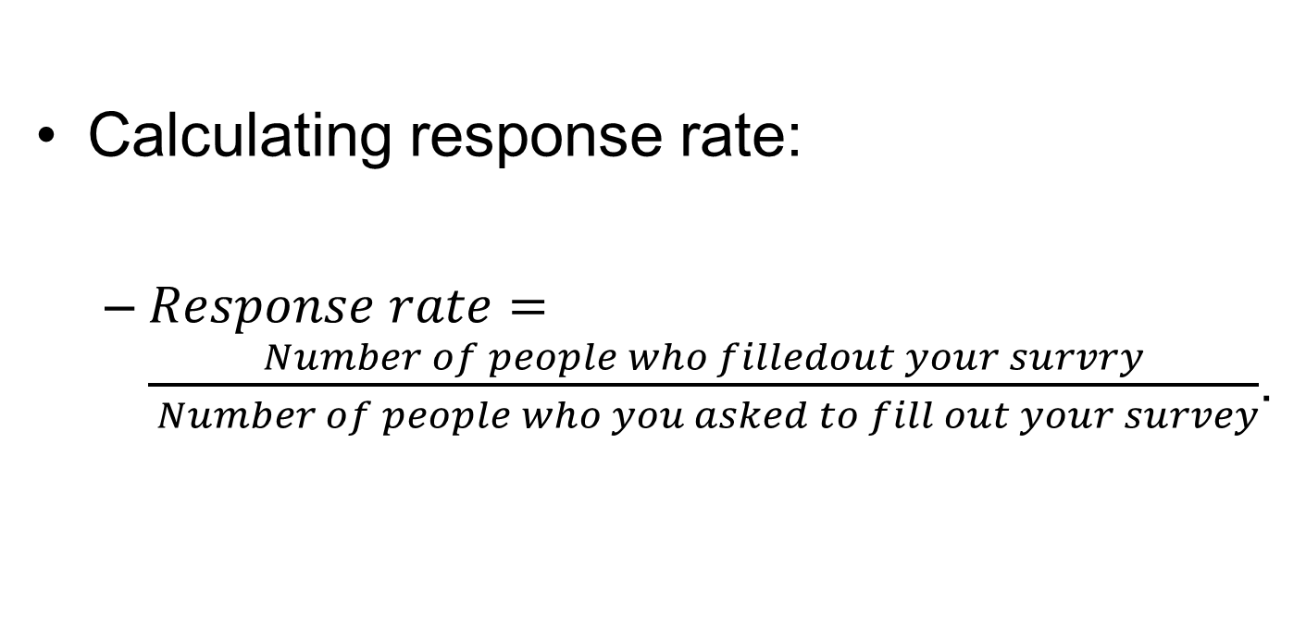
Strategies for Increasing Response Rate (8 of 8)
Calculating response rate:
  $Response rate=\frac{Number of people who filledout your survry}{ Number of people who you asked to fill out your survey}$.
Notes:
Calculating response rate:
When very few people choose to participate in a study, the researcher may be concerned.
In addition to not fulfilling the statistical requirements for a sample size, the researcher may be worried if there is something different about those who chose to take part compared to those who did not.
There is also the concern about generalizability of the results.
Response rate is one factor in judging representativeness.
But it is a useful start to compute the proportion of people who agreed to be in the study.
Response rate can be calculated by: $Response rate=\frac{Number of people who filledout your survry}{ Number of people who you asked to fill out your survey}$.

